Slide 1


ETHICS CE
A Practical Application of CFP Board’s Code and Standards
BETA
Presenting organization

Slide 2
Disclaimer
The content of this program is based on CFP Board’s Code of Ethics and Standards of Conduct (Code and Standards), which became effective on July 1, 2024.
CFP Board created and provided this slide deck to the CE Sponsor for presentation. The presenter’s opinions do not necessarily represent those of CFP Board.
All material associated with this program is the property of CFP Board and may not be resold, republished or copied without the prior written consent of CFP Board.
Copyright© 2024 Certified Financial Planner Board of Standards, Inc. All rights reserved. Reproduced with permission.
ETHICS CE: A Practical Application of CFP Board’s Code and Standards

Slide 3


Welcome to Ethics CE: A Practical Application of CFP Board’s Code and Standards
You must watch this presentation in Slide Show view.
ETHICS CE: A Practical Application of CFP Board’s Code and Standards

Slide 4
Getting the Most Out of This Course
Engage Actively
Supplemental Information
Throughout this course, you'll encounter various questions and real-world scenarios. Try your best to answer them and participate fully before proceeding to the next slide.
Read the supplemental information carefully. It contains valuable insights and details that will aid your understanding.
ETHICS CE: A Practical Application of CFP Board’s Code and Standards

Slide 5
Assessment
Engage Actively
At the end of the course, there will be a 12-question assessment to evaluate your understanding and knowledge. You must receive a passing score of 70% to receive CE credit for this course.
ETHICS CE: A Practical Application of CFP Board’s Code and Standards

Slide 6




Learning Objectives
By the conclusion of this training, participants will have improved their ability to:
Recognize when a CFP® professional is providing Financial Advice.
Apply the Fiduciary Duty.
Describe when Financial Advice requires Financial Planning and the additional obligations that apply.
ETHICS CE: A Practical Application of CFP Board’s Code and Standards

Slide 7




Learning Objectives (continued)
By the conclusion of this training, participants will have improved their ability to:
Identify duties when using or referring other service providers or technologies.
Describe the process the CFP Board follows to uphold the Code and Standards.
Determine what information must be provided to the Client and when to document the exchange of information.
ETHICS CE: A Practical Application of CFP Board’s Code and Standards

Slide 8
CODE OF ETHICS
Placeholder for video
08
ETHICS CE: A Practical Application of CFP Board’s Code and Standards

Slide 9

Code and Standards
Why is it important to have a Code of Ethics and Standards of Conduct?
What happens if CFP® professionals fail to comply with the Code and Standards?
ETHICS CE: A Practical Application of CFP Board’s Code and Standards

Slide 10
Code and Standards
Code of Ethics and Standards of Conduct
Reflects the commitment of CFP® professionals to high standards of competency and ethics
Benefits and protects the public
Your commitment to ethical behavior
A differentiator that builds public trust
Advances financial planning as a distinct and valuable profession
Violations of the Code and Standards may subject a CFP® professional to discipline
Private censure
Public censure
Temporary suspension
Revocation
ETHICS CE: A Practical Application of CFP Board’s Code and Standards

Slide 11

Code and Standards
What happens if CFP® professionals fail to comply with the Code and Standards?
ETHICS CE: A Practical Application of CFP Board’s Code and Standards

Slide 12





Code and Standards
Violations of the Code and Standards may subject a CFP® professional to discipline:
Private censure
Public censure
Temporary suspension
Revocation
ETHICS CE: A Practical Application of CFP Board’s Code and Standards

Slide 13
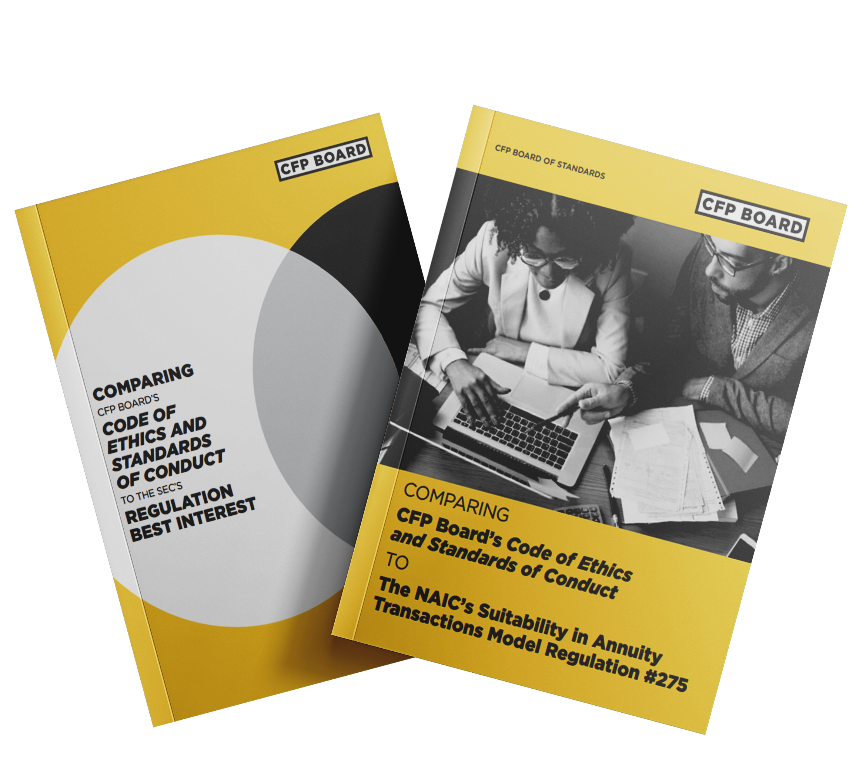
CFP Board's Compliance Resource Library
Over 35 case studies with real-world scenarios
15 guides including:
Comparison guides to Reg BI and NAIC Model Regulation
Managing Conflicts
Duty of Care
Financial Planning Process
Financial Advice Engagement Disclosure
ETHICS CE: A Practical Application of CFP Board’s Code and Standards

Slide 14
LEARNING OBJECTIVE 1
Recognize When a CFP® Professional Is Providing
Financial Advice
ETHICS CE: A Practical Application of CFP Board’s Code and Standards

Slide 15

Code and Standards
Why does it matter if I know when I’m providing financial advice?
The Fiduciary Duty, as well as other duties, apply when providing Financial Advice. Additional duties apply when providing Financial Advice that requires Financial Planning. We will look at those duties later in this course.
ETHICS CE: A Practical Application of CFP Board’s Code and Standards

Slide 16

Duties of a CFP® Professional
To Clients |  | To Firms and Subordinates | To CFP Board
At All Times | Integrity Competence Diligence Sound and Objective Professional Judgement Professionalism Comply with the Law Confidentiality and Privacy Duties When Communicating with a Client Duties When Selecting, Using and Recommending Technology Refrain from Borrowing or Lending Money and Commingling Financial Assets | Use Reasonable Care When Supervising Comply with Lawful Objectives of CFP® Professional’s Firm Provide Notice of Public Discipline | Refrain from Adverse Conduct Reporting Provide Narrative Statement Cooperation Compliance with Terms and Conditions of Certification and Trademark License
Financial Advice | The Duties That Apply At All Times (see above) Fiduciary Duty Disclose and Manage Conflicts of Interest Provide Information to a Client Duties When Recommending, Engaging and Working with Additional Persons
Financial Planning | The Duties That Apply When Providing Financial Advice (see above) The Practice Standards for the Financial Planning Process Information to Client in Writing
A CFP® Professional Has Duties That Apply
AT ALL TIMES
WHEN
PROVIDING
FINANCIAL
PLANNING
ETHICS CE: A Practical Application of CFP Board’s Code and Standards

Slide 17
Financial Advice
Definition
A communication that, based on its content, context, and presentation, would reasonably be viewed as a recommendation that the Client take or refrain from taking a particular course of action with respect to:
The development or implementation of a Financial Plan;
The value of or the advisability of investing in, purchasing, holding, gifting, or selling Financial Assets;
Investment policies or strategies, portfolio composition, the management of Financial Assets, or other financial matters; or
The selection and retention of other persons to provide financial or Professional Services to the Client;
Or
The exercise of discretionary authority over the Financial Assets of a Client.
ETHICS CE: A Practical Application of CFP Board’s Code and Standards

Slide 18

Financial Advice
Definition
Financial Advice is NOT:
A communication that, based on its content, context, and presentation, would not reasonably be viewed as a recommendation;
Responses to directed orders; and
The following, if a reasonable CFP® professional would not view it as Financial Advice:
Marketing Materials;
General Financial Education; and
General Financial Communications.
ETHICS CE: A Practical Application of CFP Board’s Code and Standards

Slide 19
Financial Advice
Definition
The determination of whether Financial Advice has been provided is an objective rather than subjective inquiry.
The more individually tailored the communication is to the Client, the more likely the communication will be viewed as Financial Advice.
ETHICS CE: A Practical Application of CFP Board’s Code and Standards

Slide 20

Scenario: Financial Advice
Kevin, a prospect, met Priya, a CFP® professional, at a retirement planning community event.
He is planning to retire next year and is looking for information.
ETHICS CE: A Practical Application of CFP Board’s Code and Standards

Slide 21

Scenario: Financial Advice
Priya sends Kevin an article titled “What will my savings cover in retirement?”
Priya sends this same article to all her Clients and prospects who are close to retirement.
This is an example of educational material that is not Financial Advice.
Practice Tip: Explicitly state in a general educational document that it is not Financial Advice.
The Duty of Integrity applies at all times. The material that Priya sent to Kevin, like all communications, must not be untrue or omit a material fact that is necessary to make the statements made not misleading.
ETHICS CE: A Practical Application of CFP Board’s Code and Standards

Slide 22

Knowledge Check – Financial Advice
True or False?
1
True or False? Fulfilling a directed order from a Client to buy a stock is Financial Advice.
The answer is: FALSE, the provision of services … that a reasonable CFP® professional would not view as Financial Advice, does not constitute Financial Advice.
But context matters: For example, providing an opinion on a stock that a client said they were interested in buying could be reasonably viewed as a recommendation with regard to that stock.
ETHICS CE: A Practical Application of CFP Board’s Code and Standards

Slide 23
Knowledge Check – Financial Advice
True or False?
2
True or False? In order for there to be Financial Advice, there must be compensation.
The answer is: FALSE, there is no requirement that a CFP® professional must be compensated for the communication to be Financial Advice.
ETHICS CE: A Practical Application of CFP Board’s Code and Standards

Slide 24
Knowledge Check – Financial Advice
True or False?
3
True or False? A CFP® professional who provides marketing materials and general financial education materials is providing Financial Advice.
The answer is: FALSE. but context matters. If it is individually tailored or a reasonable CFP® professional would view it as Financial Advice, it is likely Financial Advice. In other words, simply characterizing information as “marketing” or “educational” does not prevent it from being Financial Advice.
ETHICS CE: A Practical Application of CFP Board’s Code and Standards

Slide 25
LEARNING OBJECTIVE 2
Apply the Fiduciary Duty
ETHICS CE: A Practical Application of CFP Board’s Code and Standards

Slide 26
=
+
Duty
to Follow Instructions
+
FIDUCIARY DUTY
Duty
of Loyalty
Duty of Care
Applies at all times when providing Financial Advice to a Client.
Must act in the best interests of the Client.
ETHICS CE: A Practical Application of CFP Board’s Code and Standards

Slide 27

AT ALL TIMES
WHEN
PROVIDING
FINANCIAL
PLANNING
The Fiduciary Duty applies
ETHICS CE: A Practical Application of CFP Board’s Code and Standards

Slide 28

Duty of Care
Definition
Duty of Care is a component of the Fiduciary Duty.
You must act with the care, skill, prudence, and diligence that a prudent professional would exercise in light of the Client’s:
Goals
Risk tolerance
Objectives
Financial and personal circumstances
ETHICS CE: A Practical Application of CFP Board’s Code and Standards

Slide 29
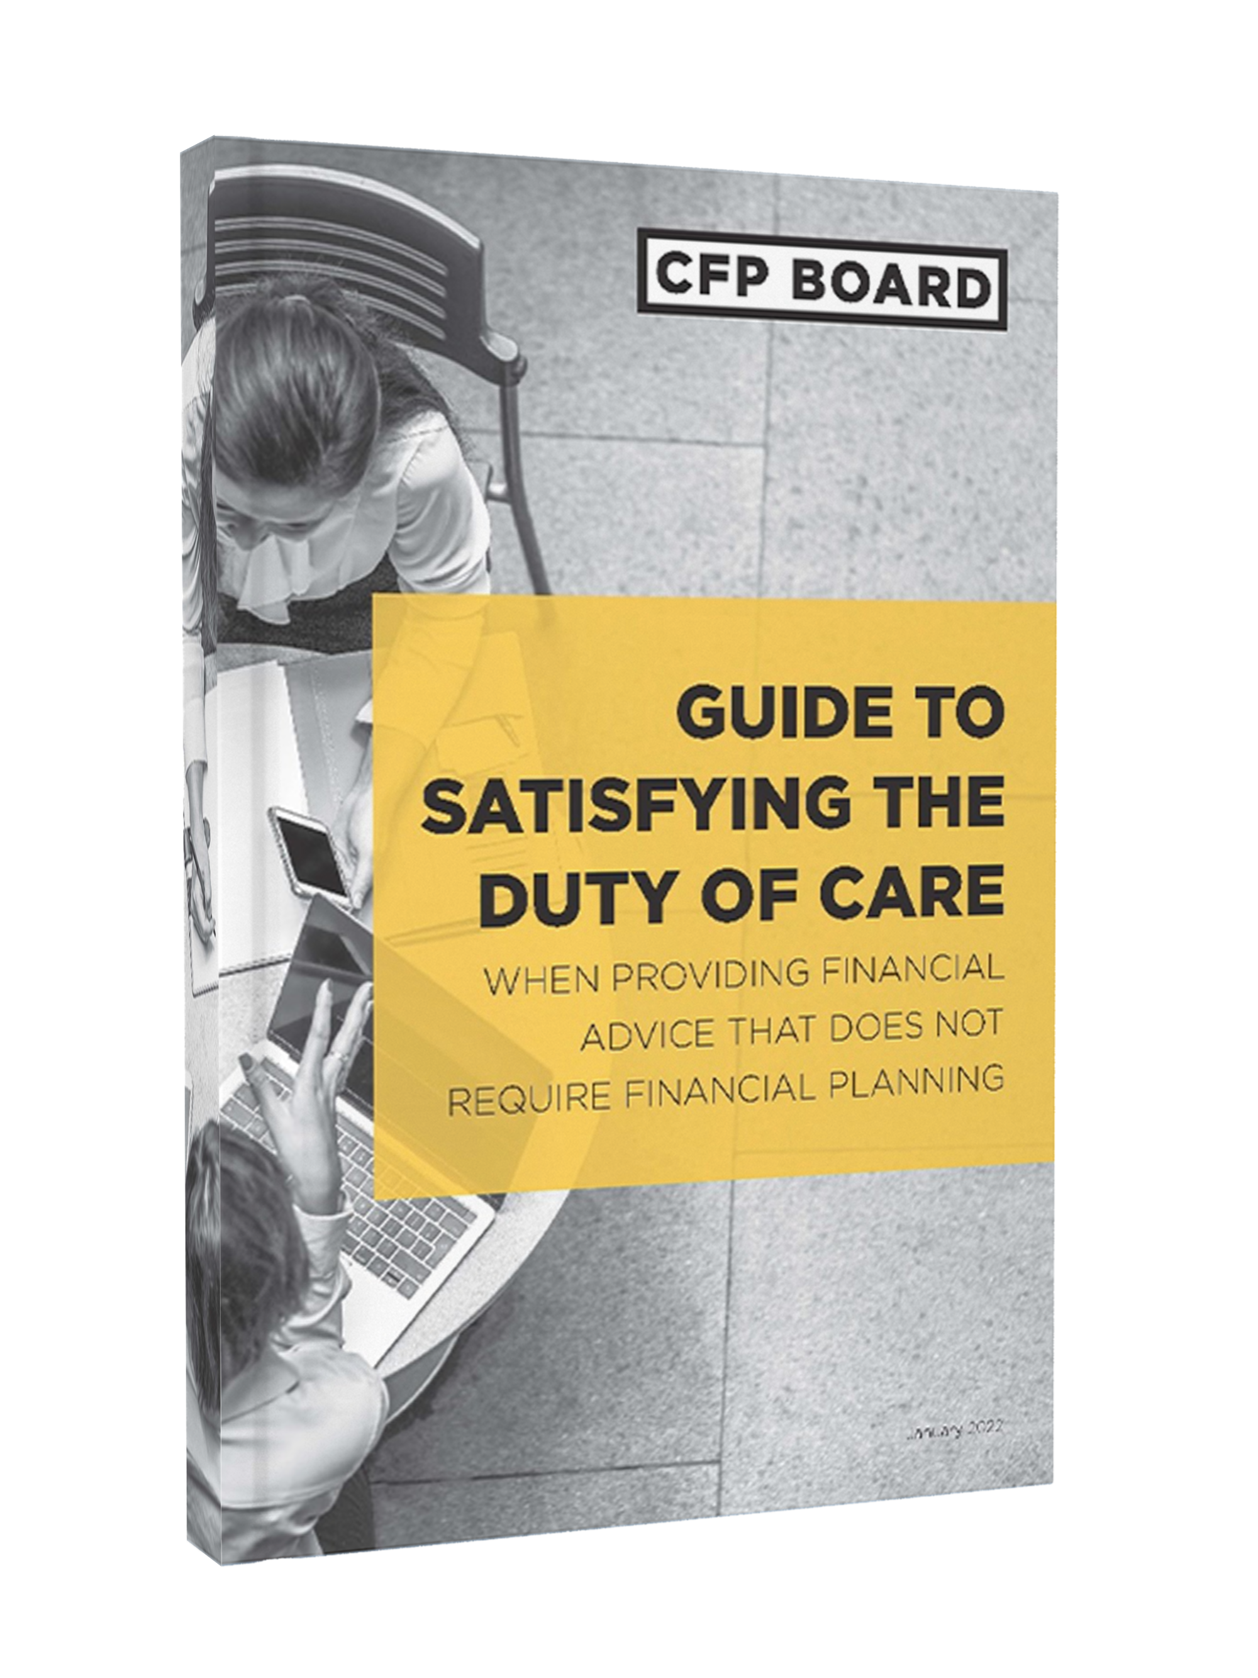
Duty of Care
Duty of Care Guide provides a process for satisfying the Duty of Care and compares them to the Practice Standards for Financial Planning.
ETHICS CE: A Practical Application of CFP Board’s Code and Standards

Slide 30







Duty of Care
Considering Whether the
CFP® Professional Must Monitor the Financial Advice
Understanding the Client’s Personal and Financial Circumstances
7
1
Implementing the Financial Advice to Fulfill the Scope of Engagement
6
Discerning the Financial Advice Required to Fulfill the Scope of Engagement
2
3
Analyzing the Current and potential Course(s) of Action to Fulfill the Scope of Engagement
Presenting the Financial Advice Recommendation(S)
5
4
Developing the Financial Advice Recommendation(s)
ETHICS CE: A Practical Application of CFP Board’s Code and Standards

Slide 31







7 Steps: Duty of Care Process
Understand the
Client
Determine
the scope of the engagement
Analyze current and potential courses of action
Develop recommendation
Present recommendation
Implement Financial Advice
Consider whether monitoring is needed
ETHICS CE: A Practical Application of CFP Board’s Code and Standards

Slide 32


Scenario: Duty of Care
Meet Jordan
Jordan is changing jobs and wants advice on what to do about her 401(k) plan.
ETHICS CE: A Practical Application of CFP Board’s Code and Standards

Slide 33

Scenario: Duty of Care
Meet Avery
Avery is a CFP® professional.
ETHICS CE: A Practical Application of CFP Board’s Code and Standards

Slide 34
True/False: Rollovers
?
True or False?
Recommending whether a Client should roll over an account from a 401(k) is Financial Advice and the Fiduciary Duty applies.
Answer: True
Financial Advice includes recommendations to take a particular course of action with respect to the management of Financial Assets. This includes rollovers.
ETHICS CE: A Practical Application of CFP Board’s Code and Standards

Slide 35

Scenario: Fulfilling the Duty of Care
Let’s follow Avery as she fulfills her Duty of Care to Jordan.
1. Understand the Client
Examples of quantitative and qualitative information to gather:
Current financial situation
Financial goals
Investment time horizon
Investor’s need for financial advice, management or planning
The need for distribution planning
ETHICS CE: A Practical Application of CFP Board’s code and standards

Slide 36

Scenario: Fulfilling the Duty of Care
Let’s follow Avery as she fulfills her Duty of Care to Jordan.
2. Discerning Advice required to fulfill Scope of Engagement
Avery will provide advice on whether Jordan should roll over and into what account.
3. Analyze the current and potential course(s) of action
Current course of action is the Client’s current 401(k).
Potential courses of action:
Rolling over into an IRA.
Rolling into current employer’s 401k account.
ETHICS CE: A Practical Application of CFP Board’s Code and Standards

Slide 37

Scenario: Fulfilling the Duty of Care
Let’s follow Avery as she fulfills her Duty of Care to Jordan.
4. Develop Recommendations
Consider the advantages and disadvantages of the course of action relative to reasonably available alternatives.
There may be more than one option that will satisfy the CFP® professional’s Fiduciary Duty to act in the best interests of the Client, including the Duty of Care.
Avery determined that two courses of action could prudently recommended to Jordan:
Remaining in her former employer’s 401(k) (i.e., not rolling over).
Rolling over into an IRA.
ETHICS CE: A Practical Application of CFP Board’s code and standards

Slide 38
Recommendations: Duty of Care
?
Does
Avery have to recommend
that Jordan remain in the 401(k)?
The fees in the former employer’s 401(k) are lower than rolling over to an IRA.
ETHICS CE: A Practical Application of CFP Board’s Code and Standards

Slide 39
Recommendations: Duty of Care
?
Does Avery have to recommend that Jordan remain in the 401(k)?
Answer: No
Costs are always a relevant factor. But they should not be the only consideration.
A recommendation that is more expensive than an alternative could be in the Client’s best interests depending on the Client’s circumstances.
For example, if Jordan decided she wanted more active management than her 401(k) provided or wanted to engage in financial planning.
ETHICS CE: A Practical Application of CFP Board’s Code and Standards

Slide 40
Scenario: Fulfilling the Duty of Care
Let’s follow Avery as she fulfills her Duty of Care to Jordan.
5. Presenting the Financial Advice Recommendation and
6. Implementing the Financial Advice Recommendation
These steps sometimes occur simultaneously.
Implementation is not always part of the scope of engagement.
Does Avery need to document her recommendation as part of presenting and implementing the Financial Advice?
ETHICS CE: A Practical Application of CFP Board’s Code and Standards

Slide 41

Documenting Recommendations
Best practice: When in doubt, DOCUMENT!
A CFP® professional should consider maintaining documents or providing documents to Clients that demonstrate compliance with the Code and Standards, even when not explicitly required by law, regulation, or the Code and Standards.
CFP® professionals also should be mindful of the Duty to Provide Information to a Client in writing, as set forth in Standard A.10.b. of the Code and Standards, when providing or required to provide Financial Planning.
ETHICS CE: A Practical Application of CFP Board’s Code and Standards

Slide 42

Scenario: Fulfilling the Duty of Care
Let’s follow Avery as she fulfills her Duty of Care to Jordan.
7. Considering whether Monitoring and Updating are required
Depends on the Scope of Engagement and the legal standards that apply to the Financial Advice.
One-time recommendation of an investment generally would not require monitoring and updating (unless agreed to).
Engagement to provide ongoing portfolio management on a discretionary basis would be required to monitor and update.
ETHICS CE: A Practical Application of CFP Board’s Code and Standards

Slide 43

Knowledge Check: Client Instructions
True or False? You must resign the Engagement if you disagree with Client Instructions.
False
You would not be required to resign from the Engagement.
You are permitted to:
Not enter into an Engagement.
Terminate the Engagement in an appropriate manner that avoids Client harm.
ETHICS CE: A Practical Application of CFP Board’s Code and Standards

Slide 44

Knowledge Check: Client Instructions
True or False? You must follow Client instructions as long as they are reasonable and lawful or limit the engagement.
TRUE
A CFP® professional must follow a Client’s reasonable and lawful directions, even if those directions might appear to require recommendations that the CFP® professional otherwise would not make.
However, at all times when providing Financial Advice to a Client, a CFP® professional must act as a fiduciary, and therefore, act in the best interests of the Client. That means that you must explain to the Client why the instructed action might not be in their best interests.
ETHICS CE: A Practical Application of CFP Board’s Code and Standards

Slide 45

Knowledge Check: Client Instructions
True or False? You must explain why you think the instructions are not in the Client’s best interests and the potential consequences of acting on the instructions.
TRUE
This principle is derived from the Duty of Care.
ETHICS CE: A Practical Application of CFP Board’s Code and Standards

Slide 46
Duty of Loyalty
Definition
A CFP® professional must:
1
Place the interests of the Client above the interests of the CFP® professional and the CFP® Professional’s Firm;
2
Avoid Conflicts of Interest, or fully disclose Material Conflicts of Interest to the Client, obtain the Client’s informed consent, and properly manage the conflict; and
Act without regard to the financial or other interests of the CFP® professional, the CFP® Professional’s Firm, or any individual or entity other than the Client, which means that a CFP® professional acting under a Conflict of Interest continues to have a duty to act in the best interests of the Client and place the Client’s interests above the CFP® professional’s.
3
ETHICS CE: A Practical Application of CFP Board’s Code and Standards

Slide 47

Conflict of Interest
Definition
Your interests (including the interests of your firm), are adverse to duties to a Client.
You have duties to one Client that are adverse to another Client (for example, when Clients divorce).
Having a Conflict ≠ Acting on a Conflict
All business models have conflicts of interest. You can have a conflict of interest, but you must manage that conflict to give Financial Advice in the Client’s best interests.
ETHICS CE: A Practical Application of CFP Board’s Code and Standards

Slide 48

Scenario: Duty of Loyalty
Meet Mei
Prospective client with 18 months worth of her expenses in a bank account.
Wants to invest and is looking for someone to help manage the investments.
Wants help developing a strategy for paying down her mortgage.
ETHICS CE: A Practical Application of CFP Board’s Code and Standards

Slide 49

Scenario: Duty of Loyalty
Meet Darren
CFP® professional compensated through a percentage of assets under management.
ETHICS CE: A Practical Application of CFP Board’s Code and Standards

Slide 50

Scenario: Duty of Loyalty
Darren’s Firm
Darren’s firm has an agreement with its clearing broker to receive payments when clients are invested in certain mutual funds.
ETHICS CE: A Practical Application of CFP Board’s Code and Standards

Slide 51




Scenario: Identify Conflicts of Interest
?
What are some of Darren’s Conflicts of Interests?
Interest in maximizing
assets under management.
Interest in giving advice
to invest assets rather than
to pay debt.
Incentive to invest in funds that will result in firm compensation – even though Darren is not directly compensated.
ETHICS CE: A Practical Application of CFP Board’s Code and Standards

Slide 52

Scenario: Identify Conflicts of Interest
?
Are these conflicts Material?
YES
Information is Material when a reasonable Client or prospective Client would consider the information important in making a decision.
Matters of compensation generally will be material.
ETHICS CE: A Practical Application of CFP Board’s Code and Standards

Slide 53
Recommendations: Duty of Care
?
Conflicts of Interest
Can Darren
avoid the conflicts of interest in this situation?
Interest in Mei maximizing invested assets
NO, it is inherent to his fee structure.
Firm’s third-party compensation arrangement
NO, he does not have control over what his firm does.
ETHICS CE: A Practical Application of CFP Board’s Code and Standards

Slide 54


Scenario: Managing Conflicts of Interest
Duty of Loyalty requires Darren to
Avoid the Conflicts of Interest, or:
1
Fully disclose Material Conflicts of Interest
2
Obtain the Client’s informed consent to the conflict
3
Manage the conflict in Client’s best interests
ETHICS CE: A Practical Application of CFP Board’s Code and Standards

Slide 55

Full Disclosure
Provide the Client with sufficiently specific facts so that a reasonable Client would be able to understand the CFP® professional’s Material Conflicts of Interest and the business practices that give rise to the conflicts, and give informed consent to such conflicts or reject them.
A sincere belief by the CFP® professional that he or she is acting in the Client’s best interest does not excuse lack of full disclosure.
Full Disclosure must occur before financial advice is given.
Evidence of oral disclosure will be given such weight as CFP Board in its judgement deems appropriate.
ETHICS CE: A Practical Application of CFP Board’s Code and Standards

Slide 56
Full Disclosure
Mere identification of how CFP® professional is paid (commission, assets under management fee, hourly fee). You need to provide an explanation of how that compensation method can affect the advice.
Typically NOT Sufficiently Specific Facts
Use of the word “may” if the conflict actually exists.
ETHICS CE: A Practical Application of CFP Board’s Code and Standards

Slide 57
Informed Consent
When can informed consent be implied?
When is informed consent less likely to be inferred?
Informed consent can be implied with full disclosure.
Magnitude of potential harm to the Client if Conflict acted upon
Extent of deviation from business practices
Ambiguity will be interpreted in favor of the Client.
ETHICS CE: A Practical Application of CFP Board’s Code and Standards

Slide 58
Scenario: Full Disclosure
How-to
Darren’s disclosures need help. Identify some problems he needs to fix.
A
“I receive an AUM fee”
Problems
Just disclosing the type of fee generally will not be sufficient. Darren needs to disclose how the fee creates an incentive that could affect the advice.
Jargon – AUM should be explained in plain language.
ETHICS CE: A Practical Application of CFP Board’s Code and Standards

Slide 59
Scenario: Full Disclosure
How-to
Darren’s disclosures need help. Identify some problems he needs to fix.
B
“My firm may have revenue sharing arrangements with mutual fund companies.”
Problems
The disclosure used the word “may” that described a conflict that actually exists.
Jargon: Mei might not understand what revenue sharing is.
ETHICS CE: A Practical Application of CFP Board’s Code and Standards

Slide 60

Written Disclosure
Written disclosure of conflicts is not required – but it is advised.
Helps clients understand the conflict.
Makes clear the information was provided: “Evidence of oral disclosure of a conflict will be given such weight as CFP Board in its judgment deems appropriate.” Code and Standards Article A.5.a.
Other regulatory requirements: Depending on the circumstance, other regulations might require written disclosure, and the Code and Standards requires compliance with other laws and regulations.
Disclosure still must be documented.
ETHICS CE: A Practical Application of CFP Board’s Code and Standards

Slide 61

Managing Conflicts of Interest
Why?
To ensure the Client’s interests come first.
What is required?
Adopt and follow business practices reasonably designed to prevent Material Conflicts of Interest from compromising your ability to act in the Client’s best interests.
ETHICS CE: A Practical Application of CFP Board’s Code and Standards

Slide 62


Managing Conflicts
Identify Material Conflicts
of Interest
Review & Evaluate Existing Practices for Management
of Conflicts
Implement Any Additional Conflict Management Practices
Develop (and periodically review and update) a comprehensive list of the Material Conflicts of Interest that may arise in the CFP®
professional’s practice.
Review the CFP® Professional’s Firm’s conflicts management or mitigation practices and any additional conflict management practices that the CFP® professional follows.
Consider any additional steps the CFP® professional needs to take to properly manage conflicts under the Code and Standards and implement any such practices.
ETHICS CE: A Practical Application of CFP Board’s Code and Standards

Slide 63
Duty of Care
?
What is a reasonably designed Business Practice?
A Prudent process consistent with the Duty of Care that is reasonably designed to result in Financial Advice that is in the Client’s best interests despite the Conflict of Interest.
ETHICS CE: A Practical Application of CFP Board’s Code and Standards

Slide 64
LEARNING OBJECTIVE 3
Describe the Financial Planning Process and the Additional Obligations That Apply
ETHICS CE: A Practical Application of CFP Board’s Code and Standards

Slide 65
Duties of a CFP® Professional
AT ALL TIMES
The Fiduciary Duty applies
The Fiduciary Duty applies AND
WHEN
PROVIDING
FINANCIAL
PLANNING
Apply the Practice Standards for the financial planning process.
Provide information to the Client in writing.
ETHICS CE: A Practical Application of CFP Board’s Code and Standards

Slide 66

Financial Planning
Financial Planning is a specific type of Financial Advice.
A collaborative process that helps maximize a Client’s potential for meeting life goals through Financial Advice that integrates relevant elements of the Client’s personal and financial circumstances.
ETHICS CE: A Practical Application of CFP Board’s Code and Standards

Slide 67

Financial Planning
When does Financial Advice Require Financial Planning?
CFP® professional agrees to provide Financial Planning ; or
Client has reasonable basis to believe Financial Planning is provided; or
CFP® Professional agrees to provide Financial Advice that requires integration of relevant elements of the Client’s personal and/ or financial circumstances in order to act in the Client’s best interests.
ETHICS CE: A Practical Application of CFP Board’s Code and Standards

Slide 68












Relevant Personal & Financial Circumstances
DEVELOP GOALS
ASSETS and LIABILITIES
CASH FLOW
RISKS
HEALTH CONSIDERATIONS
EDUCATIONAL
NEEDS
FINANCIAL SECURITY
PRESERVE or INCREASE WEALTH
TAX
CONSIDERATIONS
RETIREMENT
PHILANTHROPIC INTERESTS
ESTATE and LEGACY MATTERS
ETHICS CE: A Practical Application of CFP Board’s Code and Standards

Slide 69
Integration Factors
Number of relevant elements of Client circumstances
Portion and amount of assets
Length of time Client affected
Effect on Client’s exposure to risk
Barriers to modification of advice
ETHICS CE: A Practical Application of CFP Board’s Code and Standards

Slide 70
Integration Factors
Integration factors are used in determining whether a CFP® professional has agreed to provide or provided Financial Advice that requires Financial Planning.
ETHICS CE: A Practical Application of CFP Board’s Code and Standards

Slide 71

Scenario: Integration Factors
Pedro is a CFP® professional.
Malik, 35, is Pedro’s new Client who recently received a small inheritance.
ETHICS CE: A Practical Application of CFP Board’s Code and Standards

Slide 72
Applying the Integration Factors
Malik has no current plans for the inheritance, and he expresses that he just wants it invested in the market.
The Engagement Agreement
is explicitly limited to portfolio management of the inheritance.
Number of relevant elements
Portion and amount of assets
Length of time
Exposure to Risk
?
Is Financial Planning Required?
Probably not.
Barriers to modification
ETHICS CE: A Practical Application of CFP Board’s Code and Standards

Slide 73
Applying Integration Factors (2)
WHAT IF?
?
Several years later, Malik gets a much larger inheritance. He meets with Pedro and asks:
Is Financial Planning required?
Do I have enough to buy a larger home?
Can I provide for my 2-year-old twins’ college?
Can I leave my current job and begin investing my inheritance in real estate? Can you help with that?
ETHICS CE: A Practical Application of CFP Board’s Code and Standards

Slide 74
Applying the Integration Factors
Pedro is providing Financial Advice that requires Financial Planning.
These integration factors favor Financial Planning:
Number of elements: work, home, education, investments, retirement
Length of time: early retirement and long-term college planning
Exposure to risk and Barriers to Modifying the Actions after implementing the Financial Advice:
Investments might include illiquid assets (real estate).
Actions might include a 529 plan, which is tax-advantaged and therefore has conditions for withdrawal.
The changed circumstances indicate that the Financial Advice requires Financial Planning.
ETHICS CE: A Practical Application of CFP Board’s Code and Standards

Slide 75
Scenario: Next Steps
?
What does Pedro need to do now?
Provide, in writing, the Terms of Engagement, including:
Scope of Engagement
A CFP® professional is responsible for implementing, monitoring, and updating the Financial Planning recommendation unless specifically excluded from the Scope of Engagement.
Period of time service is provided
Client responsibilities
Apply the Practice Standards for the Financial Planning process
Provide Malik additional information in writing (discussed later in the course).
ETHICS CE: A Practical Application of CFP Board’s Code and Standards

Slide 76
The Financial Planning Process
Understanding the Client’s Personal and Financial Circumstances
Monitoring
Progress and Updating
Identifying
And Selecting
Goals
1
7
2
Analyzing Client’s Current Course of Action and Potential Alternative Course(s) of Action
Implementing
the Financial Planning Recommendation
6
3
5
4
Presenting
the financial planning
Recommendation
Developing
the Financial
Planning Recommendation
ETHICS CE: A Practical Application of CFP Board’s Code and Standards

Slide 77



Scenario: Applying Integration Factors
?
What if Malik didn’t want to engage Pedro in financial planning? What could Pedro do?
Terminate the Engagement (or do not enter an engagement with prospective clients).
Limit the Scope of Engagement to services that do not require application of the Practice Standards, and describe to the Client the services the Client requests that the CFP® professional will not be performing.
Provide the requested services after informing the Client how Financial Planning would benefit the Client and how the decision not to engage the CFP® professional to provide Financial Planning may limit the CFP® professional’s Financial Advice, in which case the CFP® professional is not required to comply with the Practice Standards.
ETHICS CE: A Practical Application of CFP Board’s Code and Standards

Slide 78
LEARNING OBJECTIVE 4
Identify Duties When Using or Referring Other Service Providers or Technologies
ETHICS CE: A Practical Application of CFP Board’s Code and Standards

Slide 79

Recommendations
The Code and Standards has two Duties that specifically address
1
Engaging, recommending and working with others; and
2
Selecting, using, and recommending Technology.
Similar principles, drawn from the Duty of Care, underlie both Duties.
ETHICS CE: A Practical Application of CFP Board’s Code and Standards

Slide 80

Scenario: Referrals
Kareem, a CFP® professional, has a financial planning Client, Javier.
Javier has decided to start a business.
ETHICS CE: A Practical Application of CFP Board’s Code and Standards

Slide 81

Scenario: Recommendations
Javier asks for recommendations for an accountant. What is required if Malik wants to make a recommendation?
ETHICS CE: A Practical Application of CFP Board’s Code and Standards

Slide 82



Scenario: Recommendations
Recommending or Engaging Additional Persons to Provide Professional Services to a Client
Reasonable basis for the recommendation:
Reputation | Experience | Qualifications
Disclosure of any compensation agreement for referring the provider
When engaging a person to provide services for a Client, exercise reasonable care to protect the Client’s interests.
Practice Tip
Consider recommending more than one person if you have a reasonable basis for each recommendation.
ETHICS CE: A Practical Application of CFP Board’s Code and Standards

Slide 83
Scenario: Recommendations
What if Javier asks Kareem if he knows of any “good” financial accounting programs for small businesses?
ETHICS CE: A Practical Application of CFP Board’s Code and Standards

Slide 84
Scenario: Tech Recommendations
Kareem is not familiar with those programs, but he wants to be helpful. Kareem knows a colleague liked CashFlow Finance Solutions. Does Kareem have enough knowledge to make a recommendation?
?
NO
ETHICS CE: A Practical Application of CFP Board’s Code and Standards

Slide 85
Technology Standard
Technology Standard
A CFP® professional must exercise reasonable care and judgment when selecting, using, or recommending any software, digital advice tool, or other technology while providing Professional Services to a Client.
A CFP® professional must have a reasonable level of understanding of the assumptions and outcomes of the technology employed.
A CFP® professional must have a reasonable basis for believing that the technology produces reliable, objective, and appropriate outcomes.
ETHICS CE: A Practical Application of CFP Board’s Code and Standards

Slide 86

Knowledge Check – Technology Recommendation
Identify the appropriate communications to Javier given Kareem’s level of knowledge.
1
I have no recommendation.
2
Cash Flow CareTaker is good.
My colleague told me they like Cash Flow CareTaker, but I do not have experience with it or other programs.
3
ETHICS CE: A Practical Application of CFP Board’s Code and Standards

Slide 87

Knowledge Check – Financial Advice
1
“I have No Recommendation.”
This is an appropriate response.
ETHICS CE: A Practical Application of CFP Board’s Code and Standards

Slide 88

Knowledge Check – Financial Advice
“You should use Cash Flow CareTaker.”
2
This is not an appropriate response. Javier could reasonably believe that Kareem has a reasonable basis for the recommendation, which he does not have.
ETHICS CE: A Practical Application of CFP Board’s Code and Standards

Slide 89

Knowledge Check – Financial Advice
“My colleague told me they like Cash Flow CareTaker, but I do not have experience with it or other programs.”
3
This is an appropriate response. Kareem provided context, including Kareem’s limited experience with the software.
ETHICS CE: A Practical Application of CFP Board’s Code and Standards

Slide 90

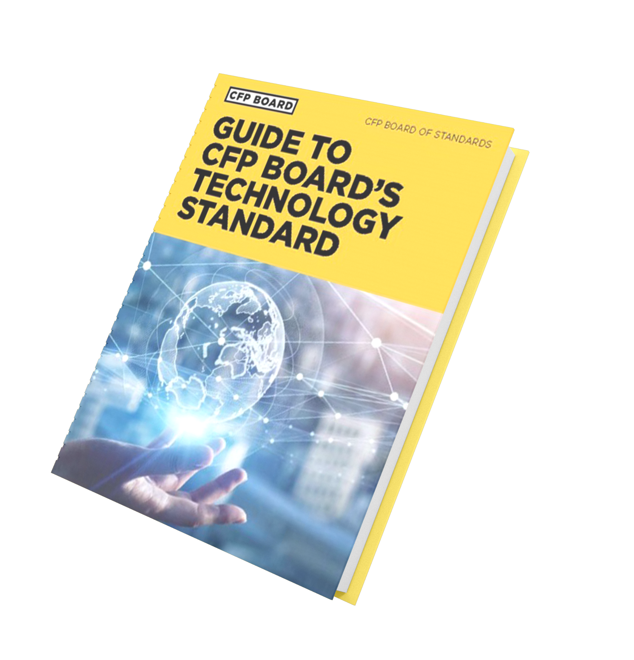
Selecting and Using Technology
Understand the Technology Platform.
Monitor the Technology Platform.
If selecting, conduct due diligence (can reasonably rely on your firm or custodian’s due diligence).
Gain necessary proficiency.
Understand embedded assumptions.
Review outcomes: A CFP® professional cannot rely on a technology’s outcomes without question or review.
Technology is a tool.
Technology does not replace expertise.
ETHICS CE: A Practical Application of CFP Board’s Code and Standards

Slide 91

Technology Standard: Helpful Resources
These guides will help you better select, use and recommend technology when working with your Clients.
ETHICS CE: A Practical Application of CFP Board’s code and standards

Slide 92
LEARNING OBJECTIVE 5
Describe the Process the CFP Board Follows to Uphold the Code and Standards
ETHICS CE: A Practical Application of CFP Board’s Code and Standards

Slide 93

Enforcement Process Overview
ETHICS CE: A Practical Application of CFP Board’s Code and Standards

Slide 94


Enforcement Process Overview
After watching the video, be prepared to answer these questions:
Which sanctions are published on CFP Board’s website?
Which statements about the Disciplinary and Ethics Commission (DEC) are TRUE?
Public censure
The DEC is comprised of CFP® professionals and members of the public
Suspension
The DEC investigates allegations
Private censure
Revocation
The DEC imposes sanctions
ETHICS CE: A Practical Application of CFP Board’s Code and Standards

Slide 95


Importance of the Duty to Report
For the value of the CFP® certification
The Duty to Report and the Duty to Cooperate are key elements of an enforcement program that seeks to detect potential misconduct.
A significant component of the value of CFP® certification is derived from the fact that CFP Board enforces the Code and Standards.
For Clients
Clients can have greater confidence that they are working with individuals who have made a commitment to act in the best interests of the Client and act with integrity and competence. The reporting and enforcement process provides credibility for the public.
ETHICS CE: A Practical Application of CFP Board’s Code and Standards

Slide 96

Importance of the Duty to Report
For individual CFP® professionals:
A CFP® professional’s failure to report the required information to CFP Board constitutes a violation of the Code and Standards, even if the matter that the CFP® professional was required to report does not reveal misconduct.
ETHICS CE: A Practical Application of CFP Board’s Code and Standards

Slide 97

Importance of the Duty to Report
The Sanction Guideline for violation of the Duty to Report is a Public Censure even if the reportable matter would not have ultimately resulted in a sanction.​
You must self-report events within 30 days.
ETHICS CE: A Practical Application of CFP Board’s Code and Standards

Slide 98

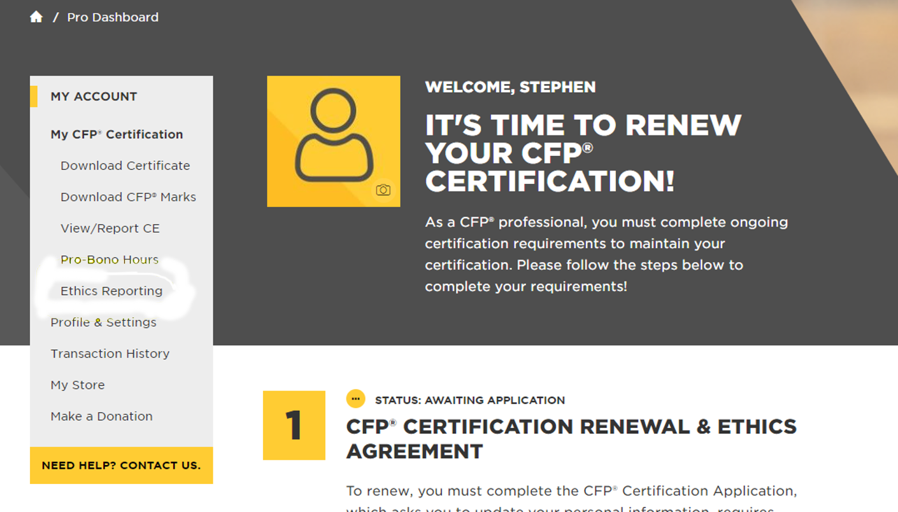
How to Report
Once a CFP® professional has accessed their account to make a report, they will navigate to the tab that is titled Ethics Reporting.
This tab is accessible through the dashboard shown here. Once a CFP® professional submits a report, the information is stored permanently within that user’s account.
A CFP® professional may seek guidance
on the Duty to Report by contacting
compliance@cfpboard.org.
ETHICS CE: A Practical Application of CFP Board’s Code and Standards

Slide 99

Reporting – General Categories
Regulatory or SRO Investigations or actions
License suspension or revocation
Felonies and certain misdemeanors
Customer complaints
Termination for regulatory or firm policy violation
Litigation or arbitration
Bankruptcies and liens
This is an Overview only. Please refer to the Code and Standards Article E.3 and the Duty to Report Brochure for full requirements
ETHICS CE: A Practical Application of CFP Board’s Code and Standards

Slide 100

Reporting – Common Mistakes
Waiting until next renewal cycle to report. Reporting is required within 30 days.
Waiting to report a complaint until the firm has investigated or until the next renewal. Reporting is required at the initiation of a complaint.
Not reporting events unrelated to Professional Services. Some events that require reporting do not have to involve Professional Services.
Assuming your firm will handle reporting.
ETHICS CE: A Practical Application of CFP Board’s Code and Standards

Slide 101
LEARNING OBJECTIVE 6
Determine what Information Must be Provided to the Client and When to Document the Exchange of Information
ETHICS CE: A Practical Application of CFP Board’s Code and Standards

Slide 102
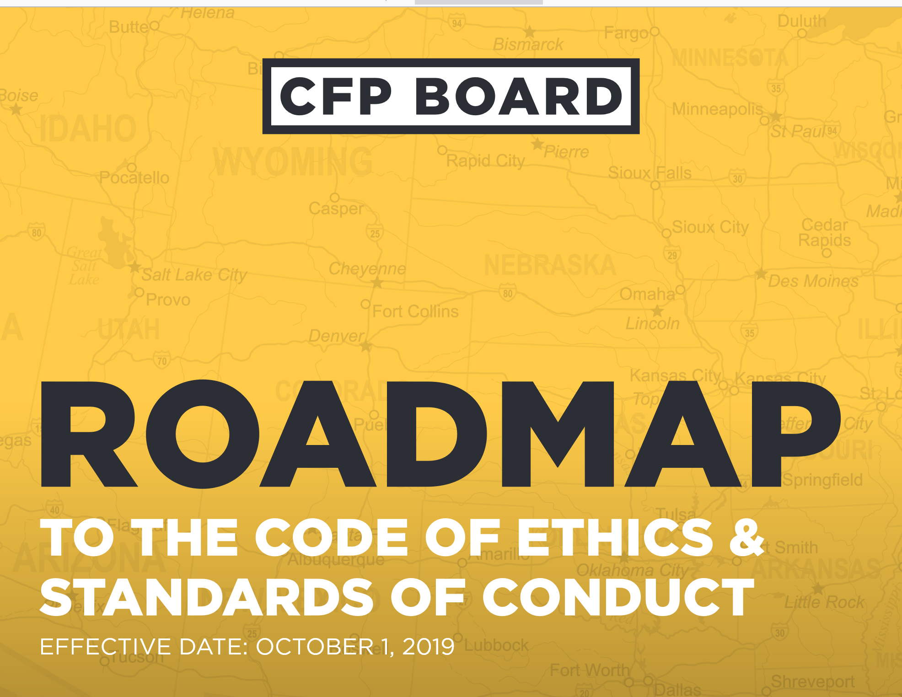
Providing Information – Guidance
The Roadmap includes the Financial Advice Engagements Disclosure Guide (p. 10) and the Financial Planning Engagements Disclosure Guide (p. 14).
ETHICS CE: A Practical Application of CFP Board’s Code and Standards

Slide 103
All Financial Advice Arrangements
Information must be provided to the client in all Financial Advice arrangements at or before the Time of Engagement.
You must document that you have provided the information to the Client even if the information is not provided in writing.
Best Practice
For CFP® professionals in firms, understand whether your firm retains the information that the Code and Standards requires you to document. You may allow a firm to document the information for you, but you have ultimate responsibility to ensure documentation occurs.
ETHICS CE: A Practical Application of CFP Board’s Code and Standards

Slide 104


Duty to Provide Information to a Client
Financial Advice
Financial Planning
Provide in One or More Written Documents
Provide Orally or in Writing
Provide in One or More Written Documents
Provide Orally or in Writing
Privacy Policy
Material Conflicts of Interest
Privacy Policy
Material Conflicts of Interest
Services and Products
Services and Products
How the Client Pays
How the Client Pays
How you, your Firm, and Related Parties are Compensated
How you, your Firm, and Related Parties are Compensated
Public Discipline and Bankruptcy
Public Discipline and Bankruptcy
Referral Compensation Arrangements
Referral Compensation Arrangements
Other Material Information
Terms of Engagement (Implementing, Monitoring, and Updating Is Required Unless Explicitly Excluded)
Other Material Information
ETHICS CE: A Practical Application of CFP Board’s Code and Standards

Slide 105


When to Provide Information
Timing
Updating
The required information must be provided prior to or at the time of the Engagement.
A CFP® professional has an ongoing obligation to provide to the Client any information that is a Material change or update to the information required to be provided to the Client.
Within 90 days for bankruptcy or public discipline
ETHICS CE: A Practical Application of CFP Board’s Code and Standards

Slide 106

Providing Information
The Code and Standards requires the CFP® professional to document that they provided the information (such as in a Customer Relationship Management System) even if they are not required to provide information in writing.
ETHICS CE: A Practical Application of CFP Board’s Code and Standards

Slide 107

Seeking Guidance
CFP BOARD RESOURCES!
ETHICS CE: A Practical Application of CFP Board’s Code and Standards

Slide 108
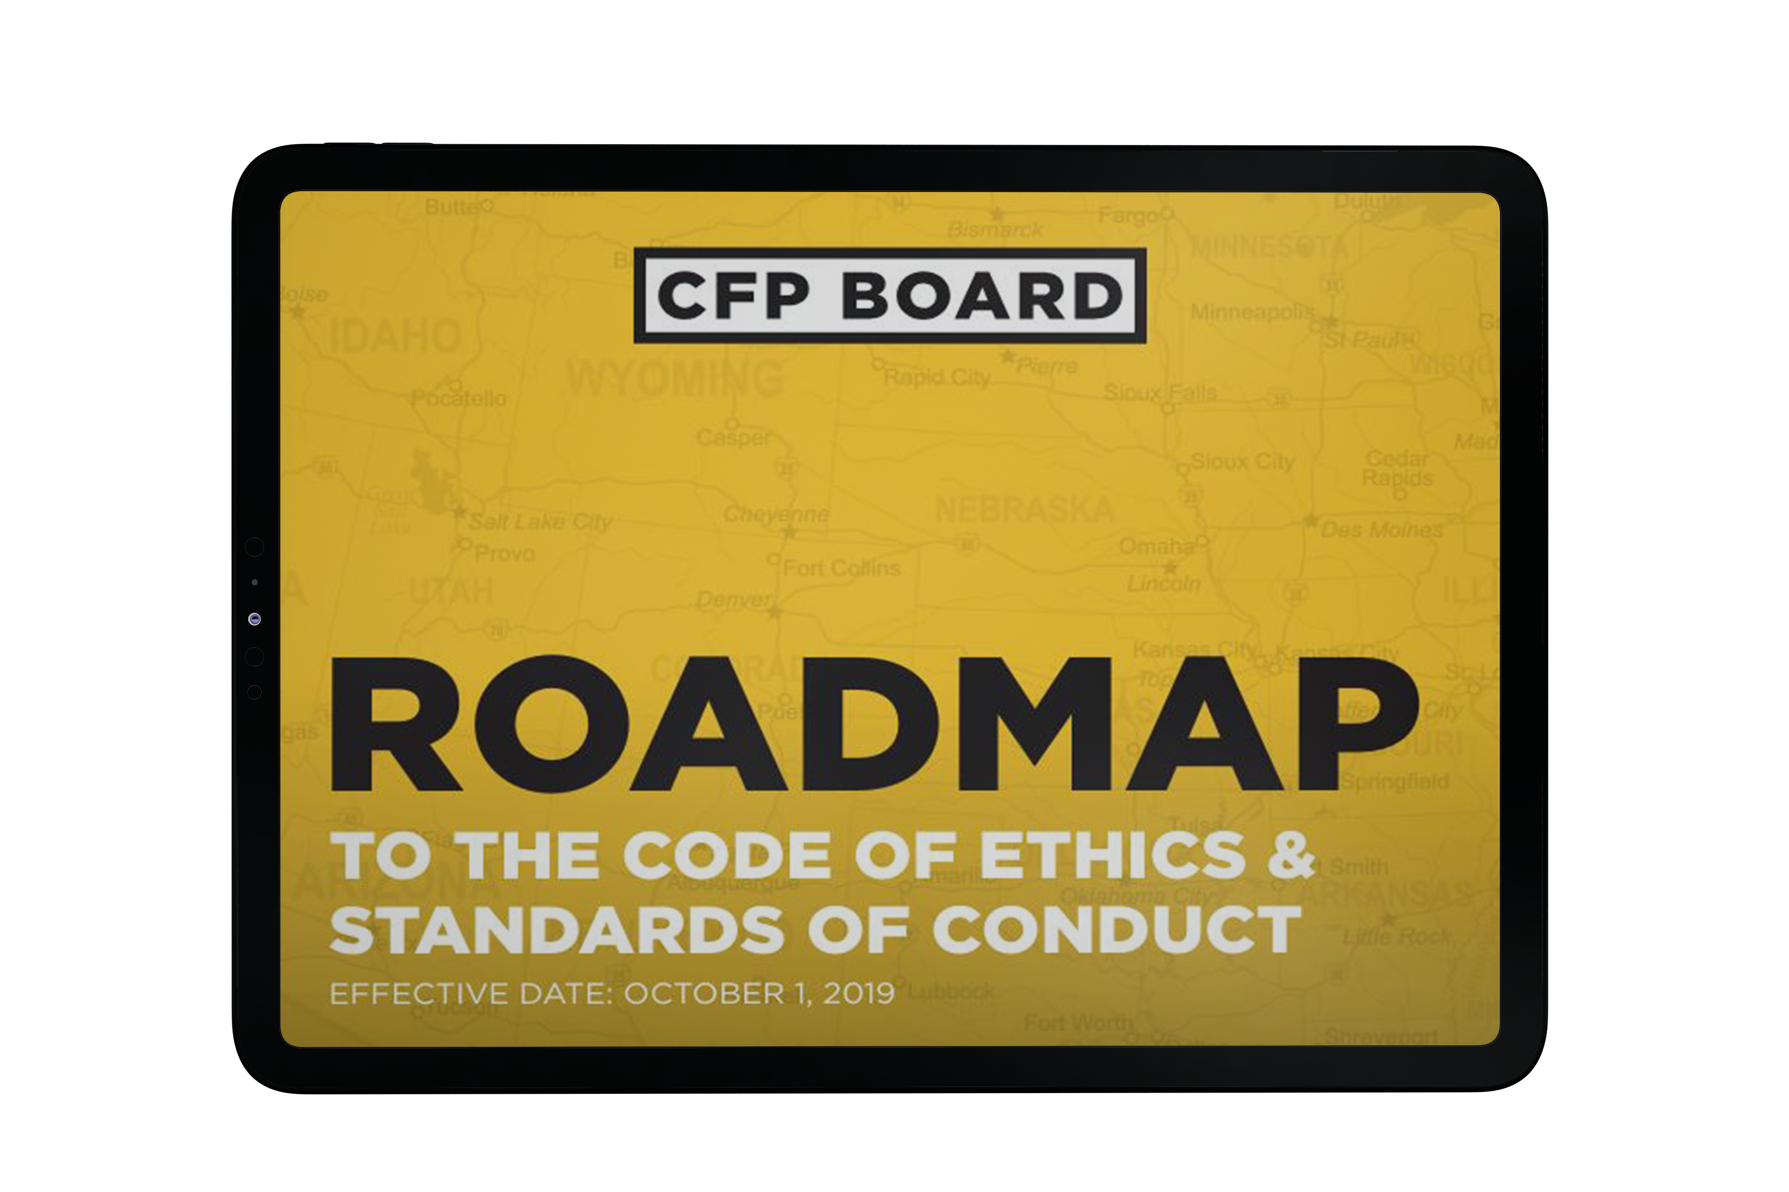
CFP Board Resources
Roadmap to the Code of Ethics & Standards of Conduct
ETHICS CE: A Practical Application of CFP Board’s Code and Standards

Slide 109
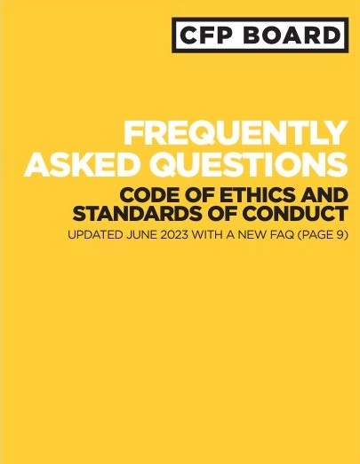
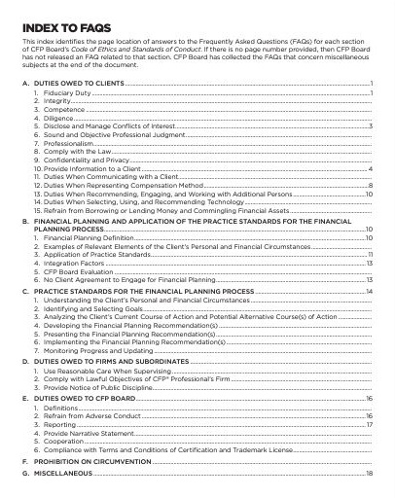
CFP Board Resources
FAQs
ETHICS CE: A Practical Application of CFP Board’s Code and Standards

Slide 110
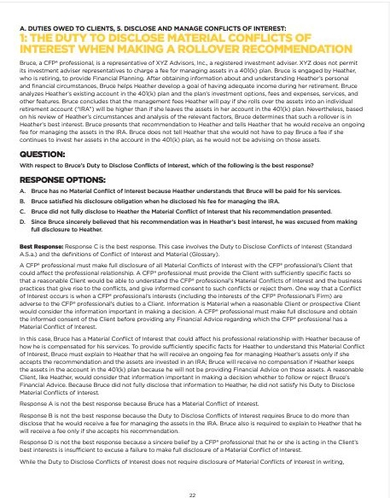
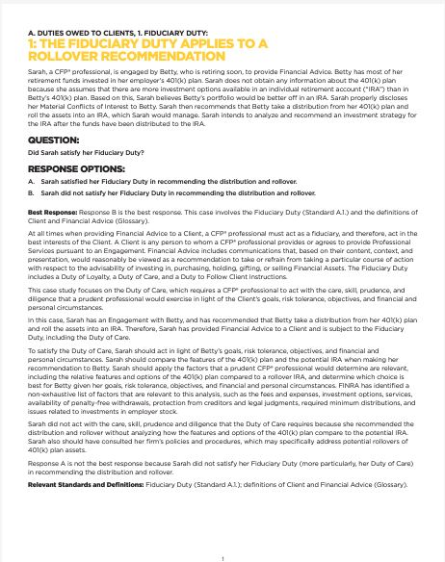
CFP Board Resources
Case studies
ETHICS CE: A Practical Application of CFP Board’s Code and Standards

Slide 111
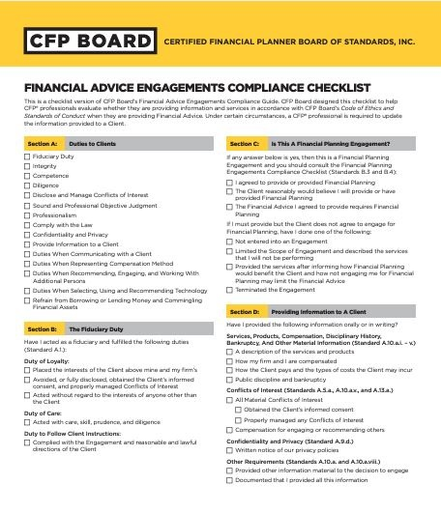
CFP Board Resources
Checklists and Guides
ETHICS CE: A Practical Application of CFP Board’s Code and Standards

Slide 112
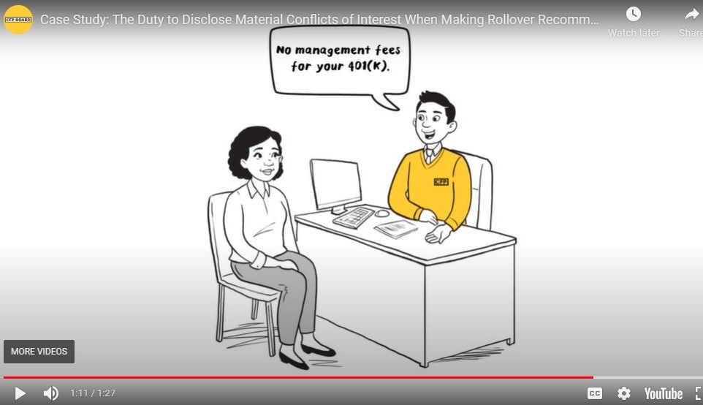
CFP Board Resources
Videos and webinars
ETHICS CE: A Practical Application of CFP Board’s Code and Standards

Slide 113
CONGRATULATIONS!
You have completed the course Ethics CE: A Practical Application of CFP Board’s Code and Standards
ETHICS CE: A Practical Application of CFP Board’s Code and Standards

